Slide 1
BOSTON, MA
ANALYSIS OF THE REAL ESTATE MARKET

Slide 2
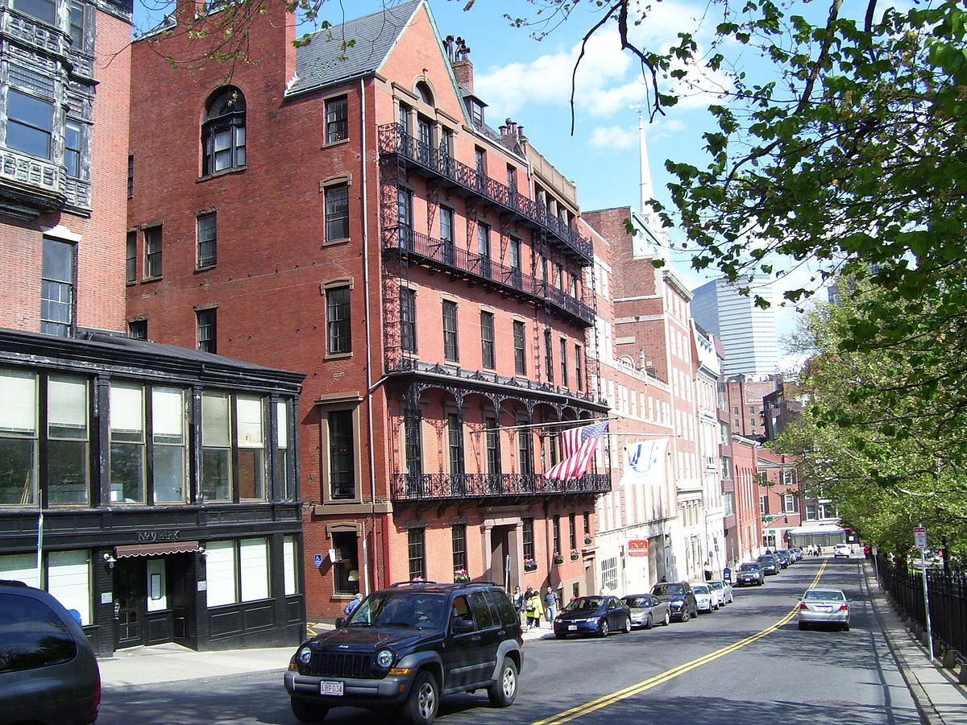
Notes:
Boston is an old city where the houses are passed from one generation to another base on our research on the internet.

Slide 3
Our model
Our model has shown that there are about 7 zip codes in Boston where investor can invest with a possibility to have at least 10% return on investment. This is insignificant if you take in consideration that house comes with some major expenses. The maximum of 14% in some zip code may be appealing but still not enough.

Slide 4
Conclusion
Investing in Boston doesn’t seem to be a recommendation I will do the stakeholder, especially those looking to make gain and move on.
For the patient investors looking for small consistent return on investment , they can invest in these 3 zip codes in Boston: 02124, 02111 and 02126; they all have a return of 14%, 13% and 13%

Slide 5
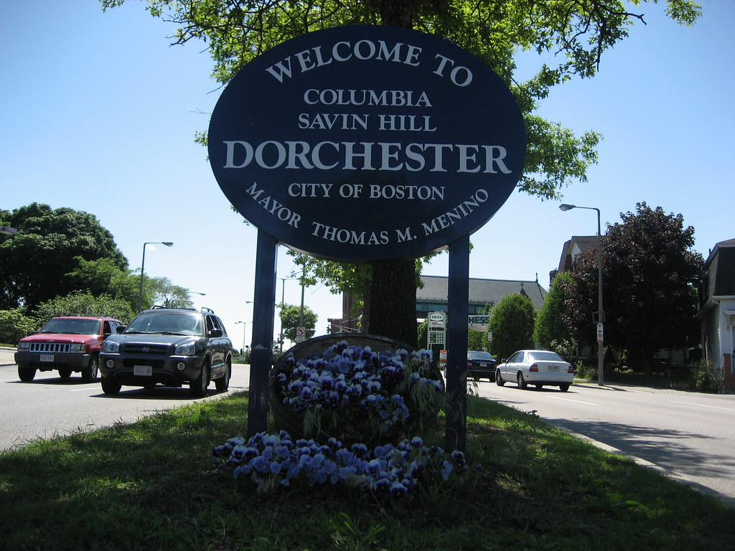
City of Dorchester, MA
This city is in the perimeter of zip code of 02126, the best zip code where to invest in Boston.

